Slide 1
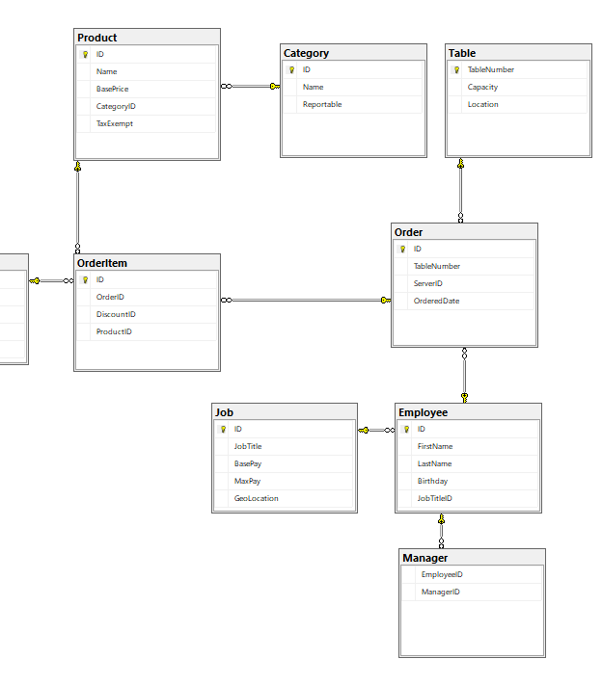
QuickOrder Shop
Steven Starlin

Slide 2
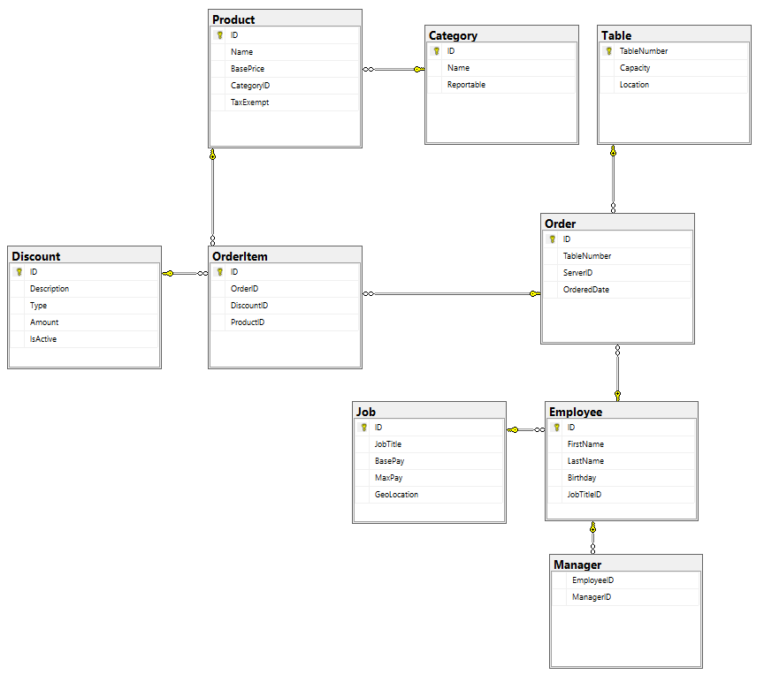
Database Diagram
The entire database looks like this!

Slide 3
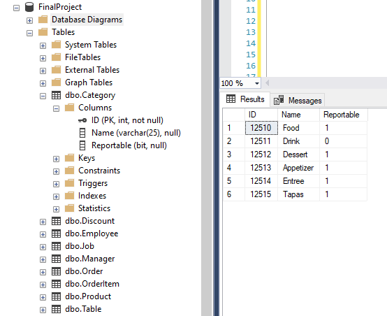
Categories
All products belong to categories defined in this table

Slide 4
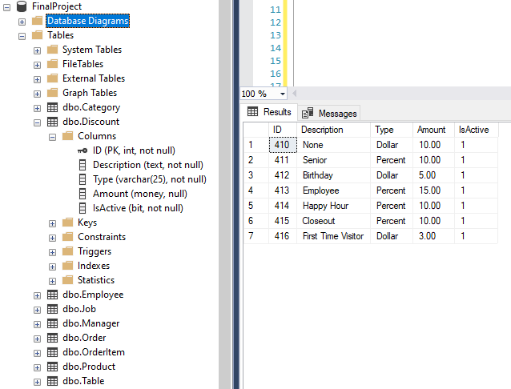
Discount
Discounts get applied to orders entered into the Order table

Slide 5
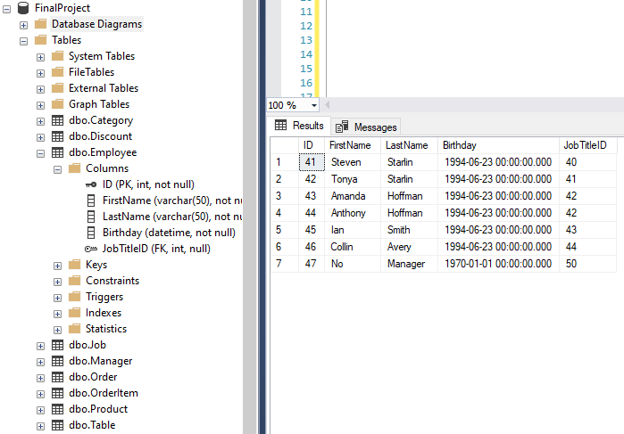
Employee
Just like it sounds, this table holds employee data

Slide 6
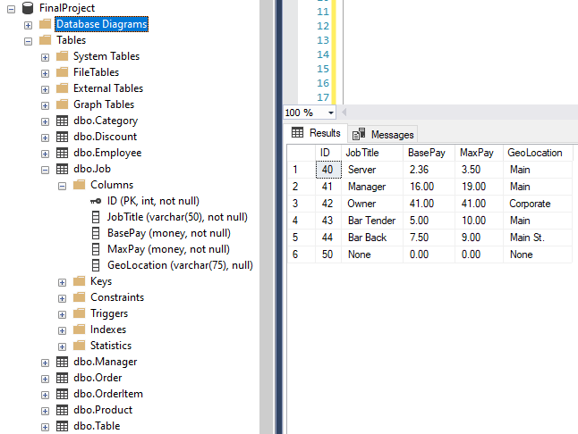
Job
Each employee gets their job details tracked through this table

Slide 7
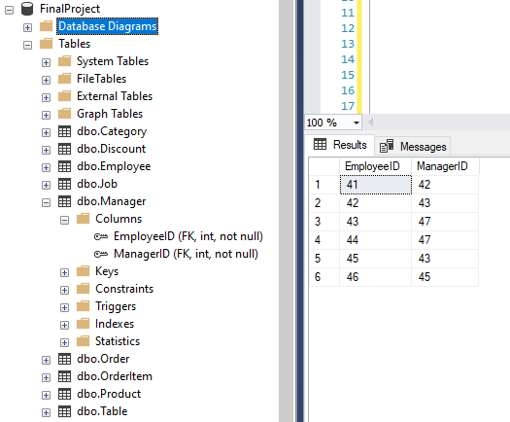
Manager
Everyone reports to someone! Except for those who report to ID 47

Slide 8
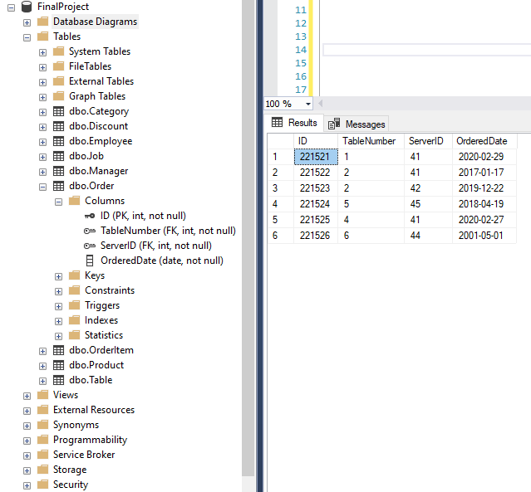
Order
This keeps track of the header info for each order. Basically, this is the stuff that doesn’t change or get added to.

Slide 9
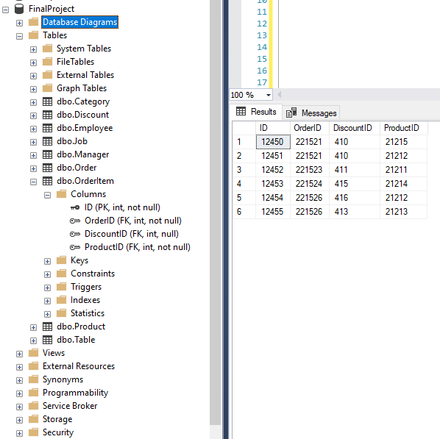
OrderItem
Here’s where your food is. Rather, the data related to your food… It kinda bytes.

Slide 10
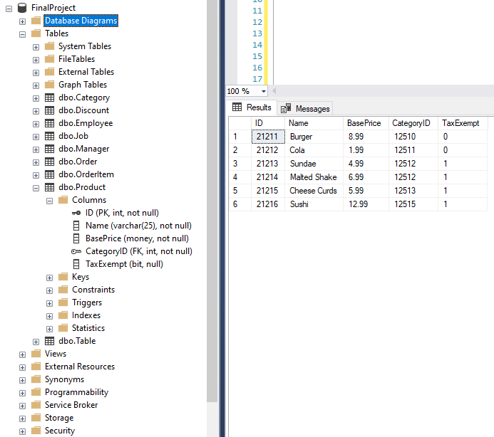
Product
People like to buy things. So let’s find a place to store stuff data. Data related to stuff they want to buy.

Slide 11
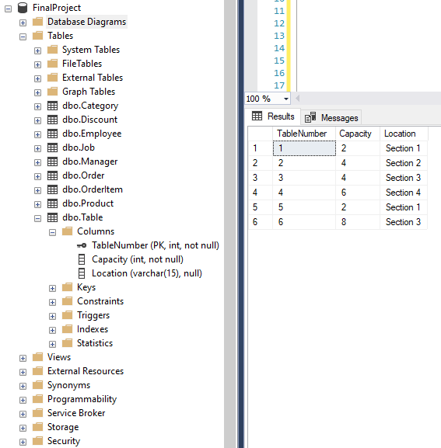
Table
People need places to sit! So here’s the tables and how many people can sit there.

Slide 12
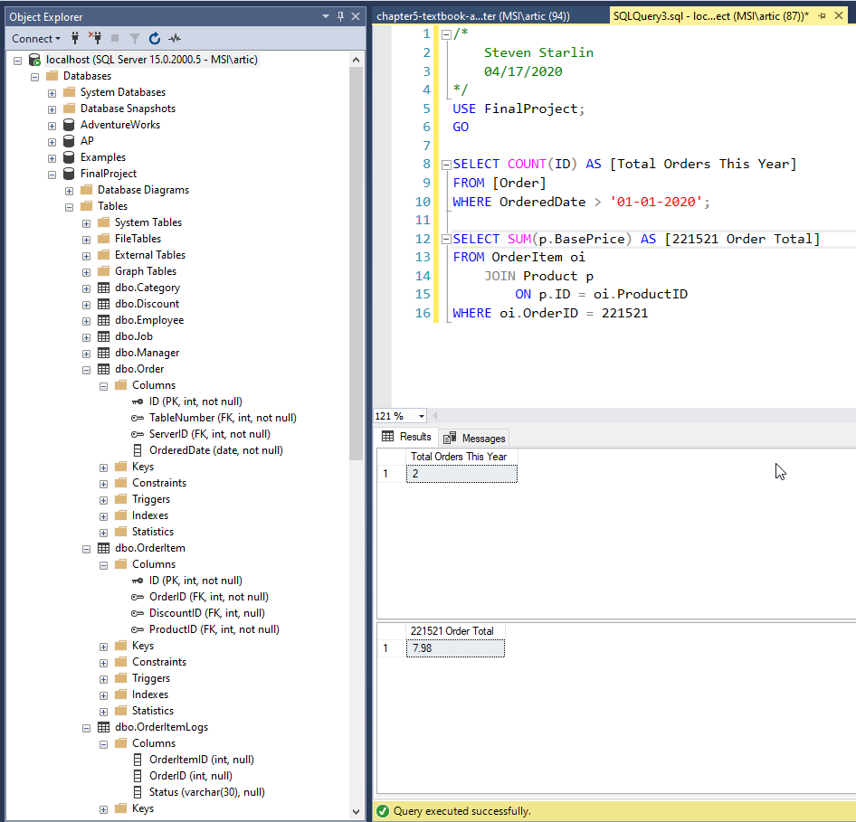
Summary Queries
Summary queries show data line the total orders for this year, or the total amount spent on an order given.

Slide 13
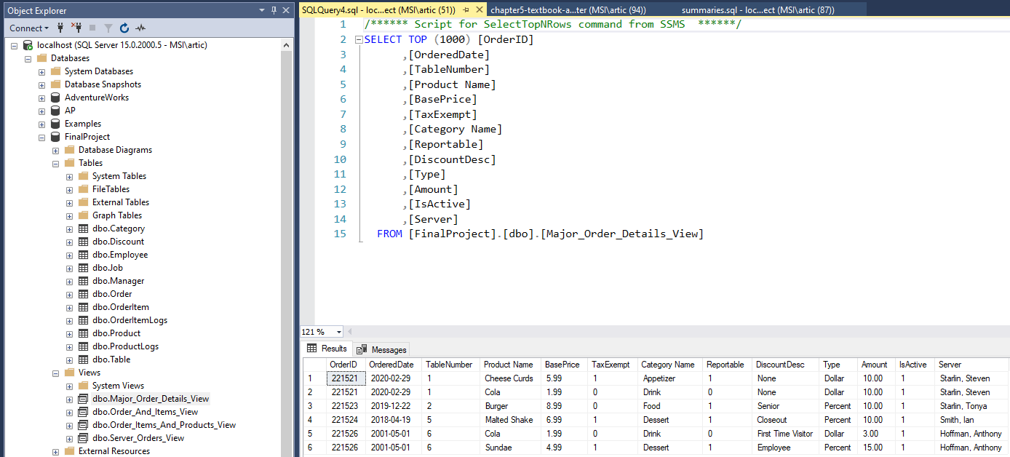
One View shows major order info

Slide 14
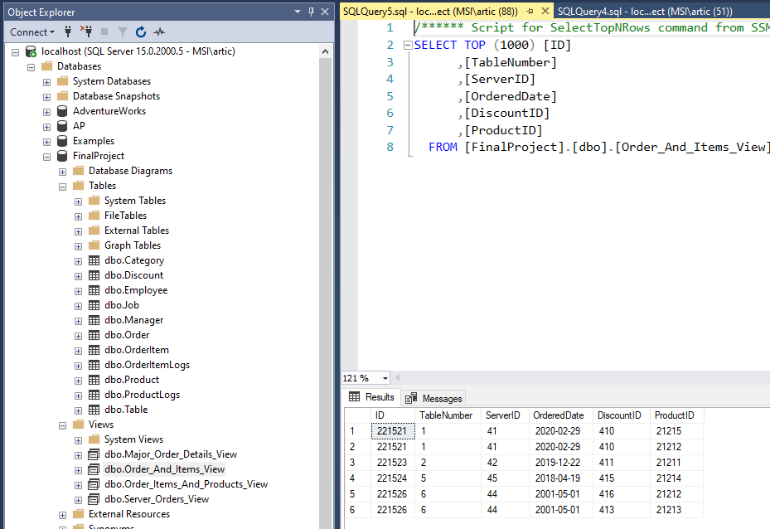
View 2
Another view shows the order items and their respective order

Slide 15
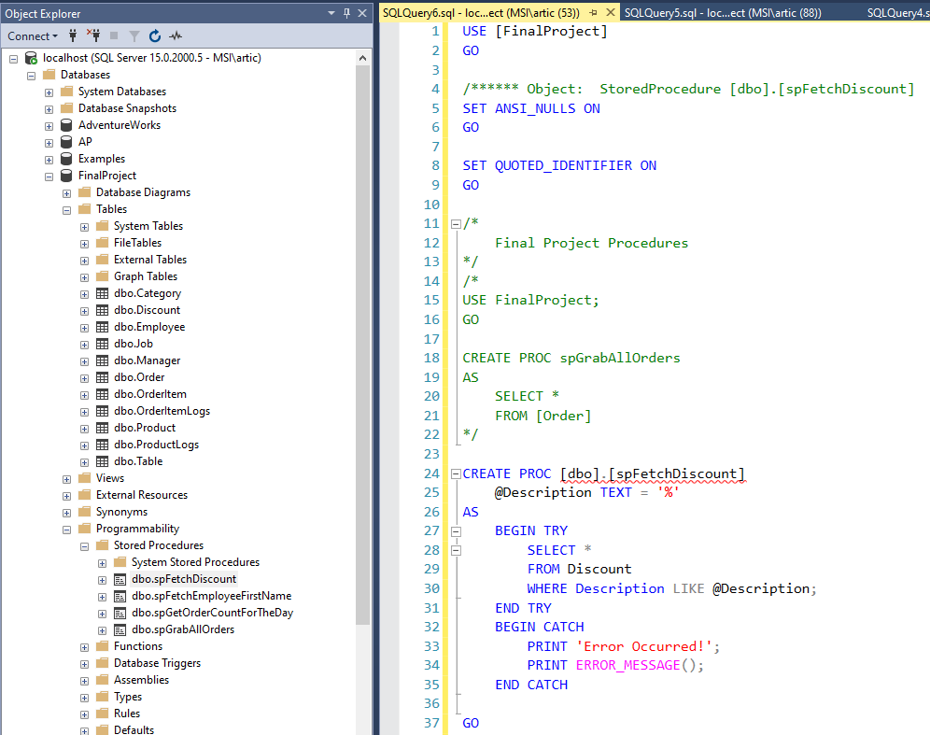
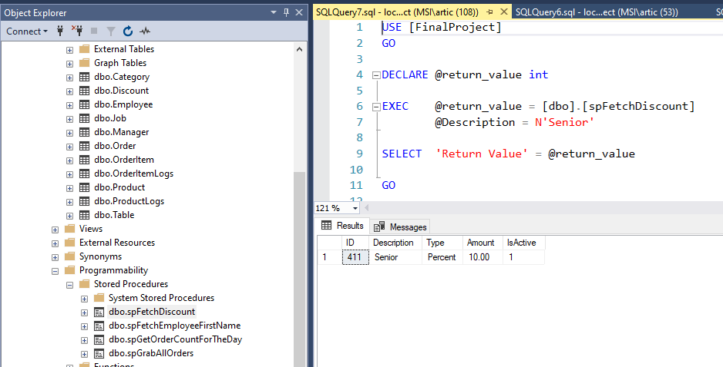
Stored Procs
The first stored procedure fetches a specific discount

Slide 16
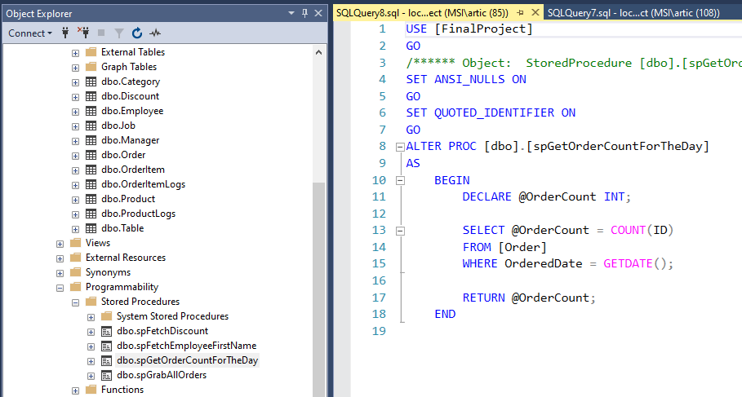
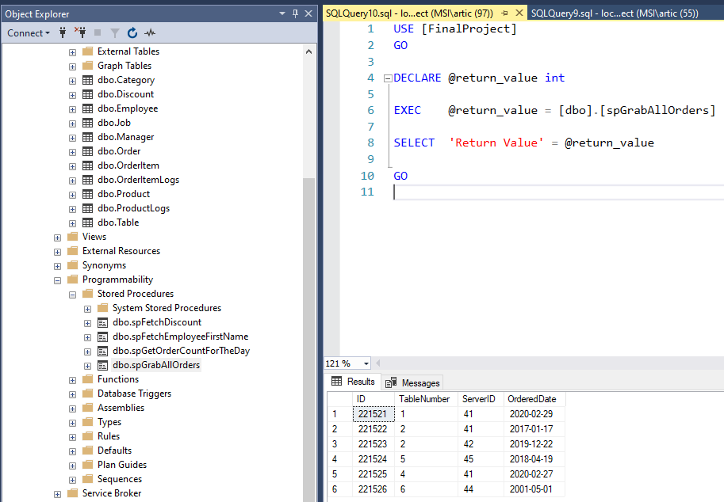
Stored Procs 2
The second SP shows the Order count of the DB.

Slide 17
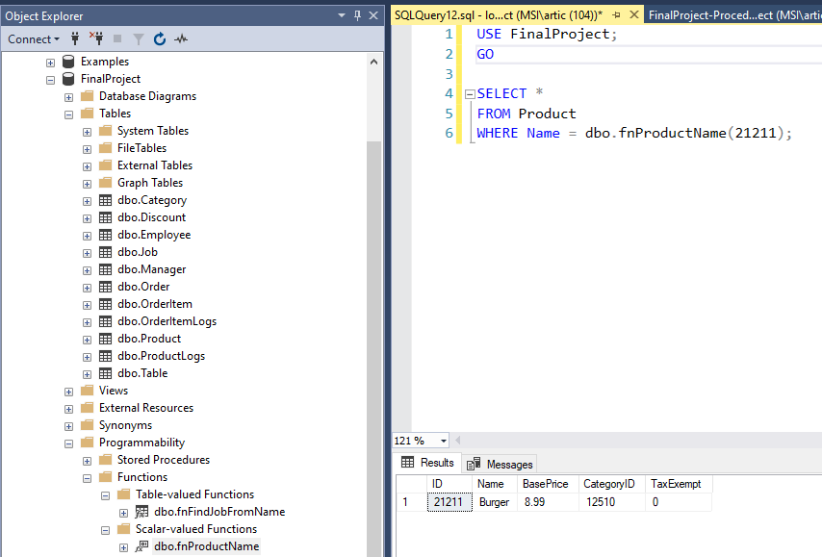
Getting a Product By ID

Slide 18
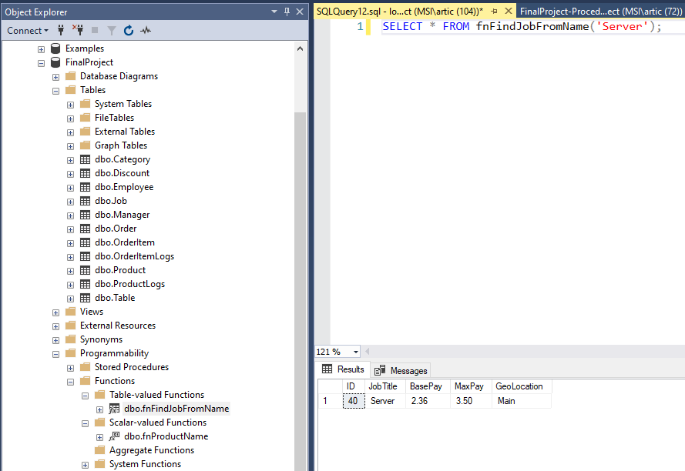
Function to Grab Server job details

Slide 19
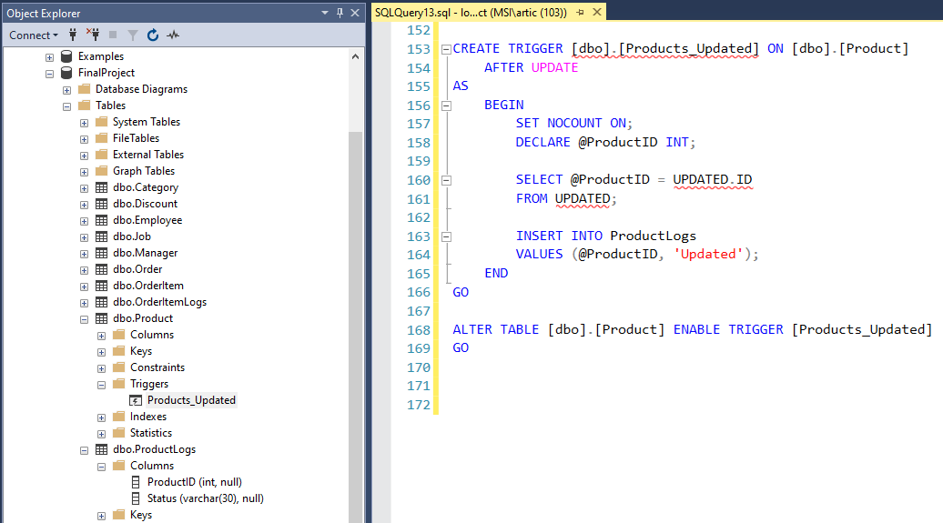
Triggers
When a product is modified in the database, the update gets logged in the ProductLogs table

Slide 20
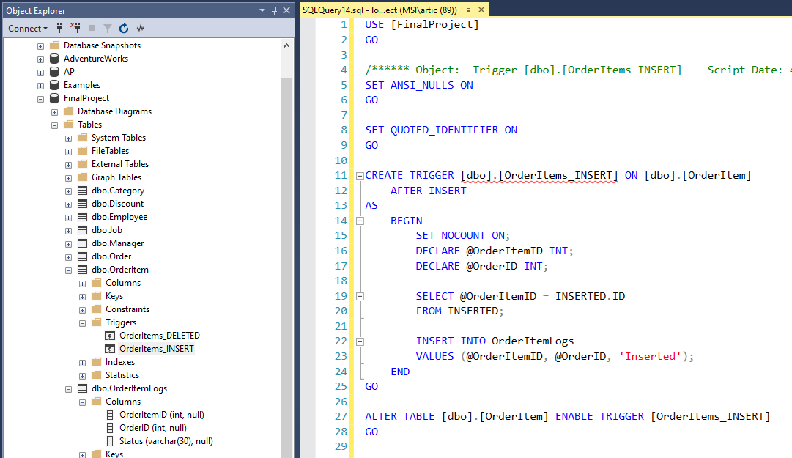
Triggers II
When an order item is inserted into the database, we log it to check accuracy of order entry.

